Slide 1
CrowdPower: Events/Crowds
Dartis Willis
Cristian Lara
Neven Wang -Tomic

Slide 2

Needfinding Methodology
Multiple unique viewpoints
People who attended the event
People who directed the event
People with a vested interest in an “ideal” event experience
We wanted to know:
How did they find out about the event/How did they advertise the event?
How accurately did they anticipate the crowd?
Did crowd level affect their experiences at events?

Slide 3
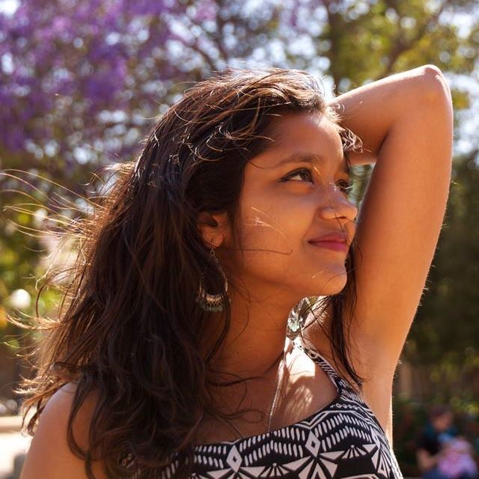
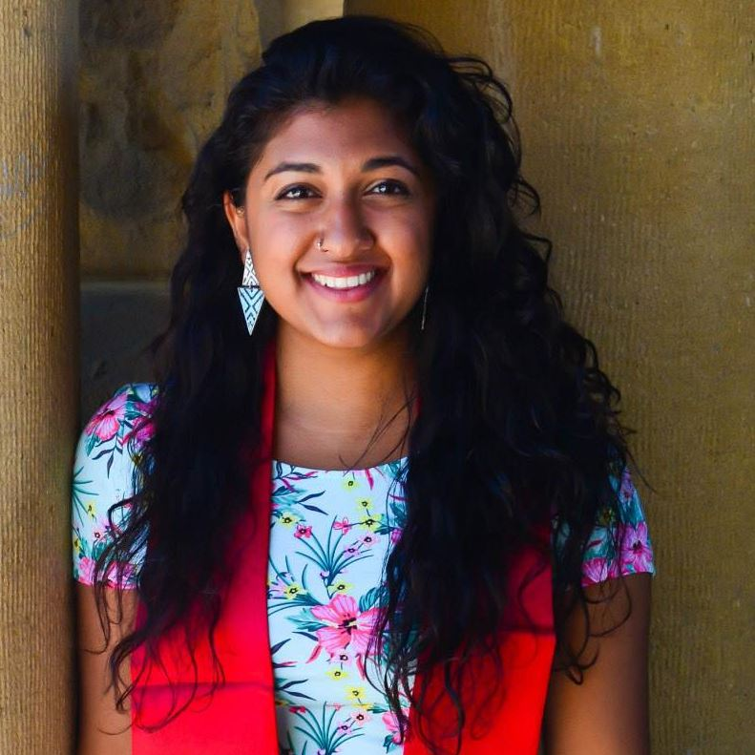
Computer Forum Career Fair
Deeksha Goyal
Janhavi Vartak
Stanford Junior
CS Major
Spontaneous Interview
Looking for summer internship
Part of the primary target audience
Stanford Alumni
Graduated 2017
STS Major
Looking for career opportunities
Event intended for people like her, very important to her as well

Slide 4
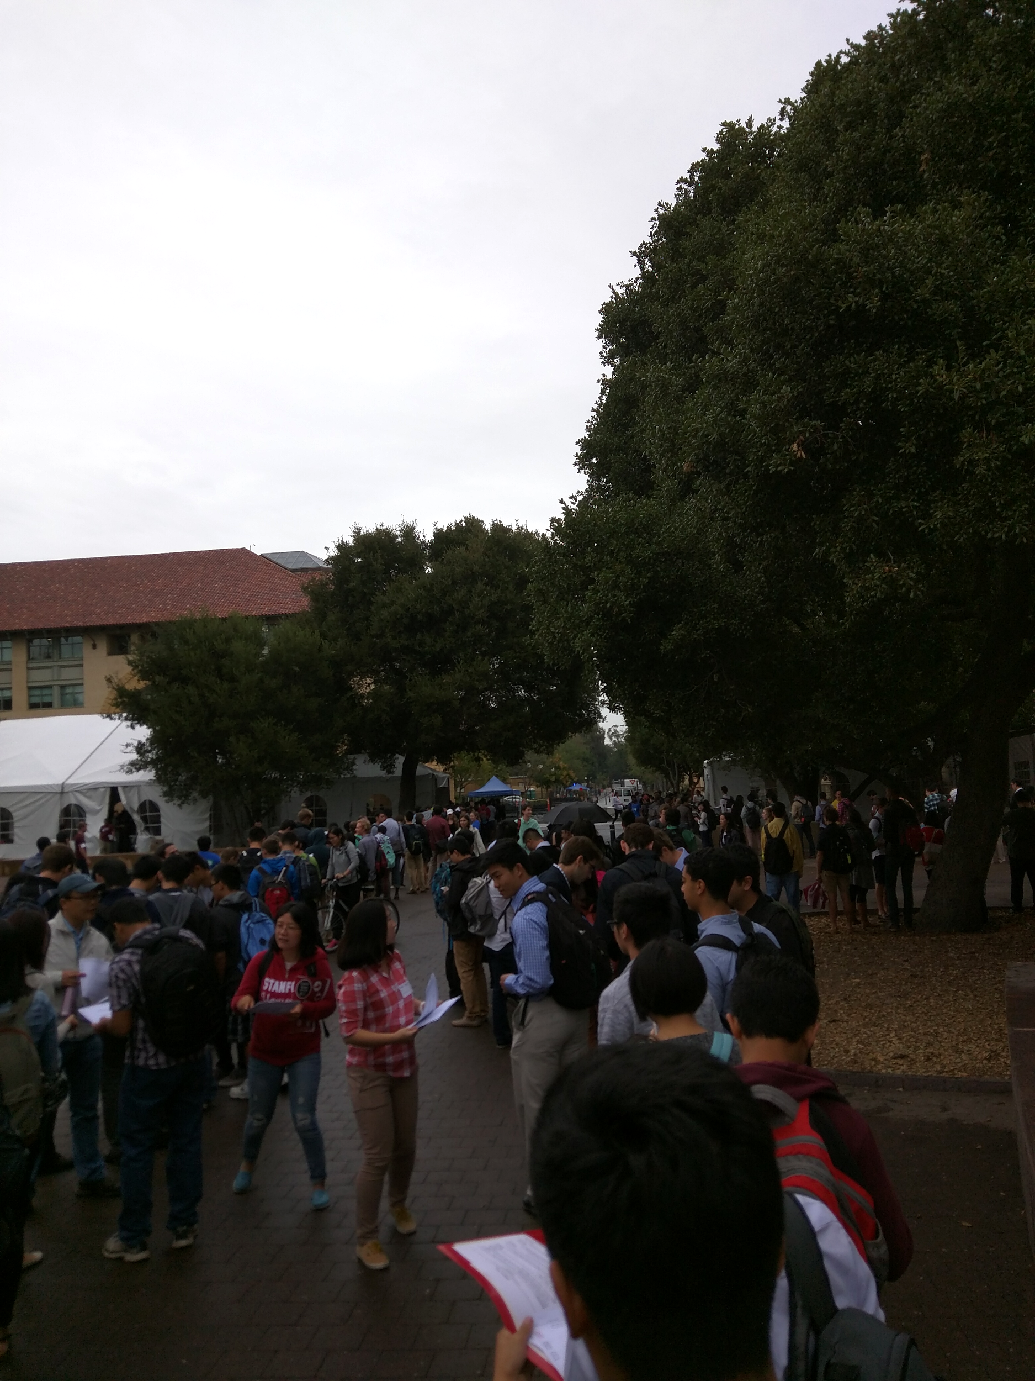
Interview Results
Computer Forum Career Fair
Janhavi
Found out about the event through Handshake.
Accurately anticipated the crowd’s levels, but was still not mentally prepared.
Was determined to attend, still felt reservation on arrival.
“The line and crowd as I entered was terrifying”
Deeksha
Found out about the event through email.
She had an idea about how busy it was going to be, but she wasn’t exactly sure. She had to go “on a hunch”.
Would have been helpful if there were some way for her to know what the crowd at the event was like.

Slide 5
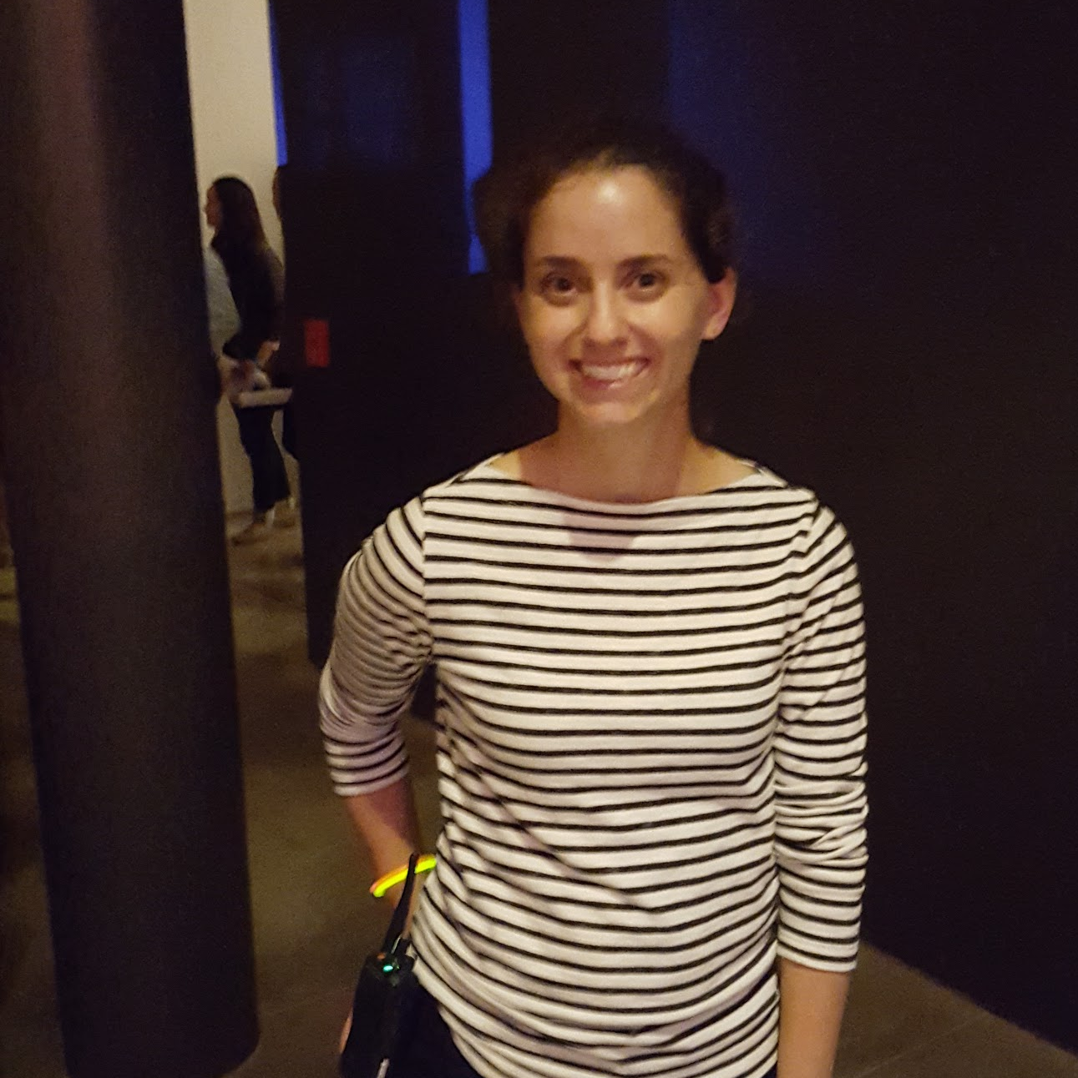
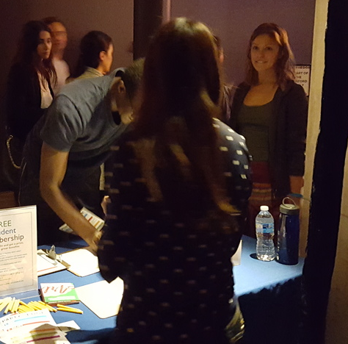
Party On the Edge: Cantor Art Gallery
Kim Mansfield
Lauren Wang + Other Staff
Cantor Center Employee
Event Coordinator
Responsible for creating “engaging” environment for students
Cantor Center Employee
Event Staff
Responsible for soliciting memberships from guests

Slide 6
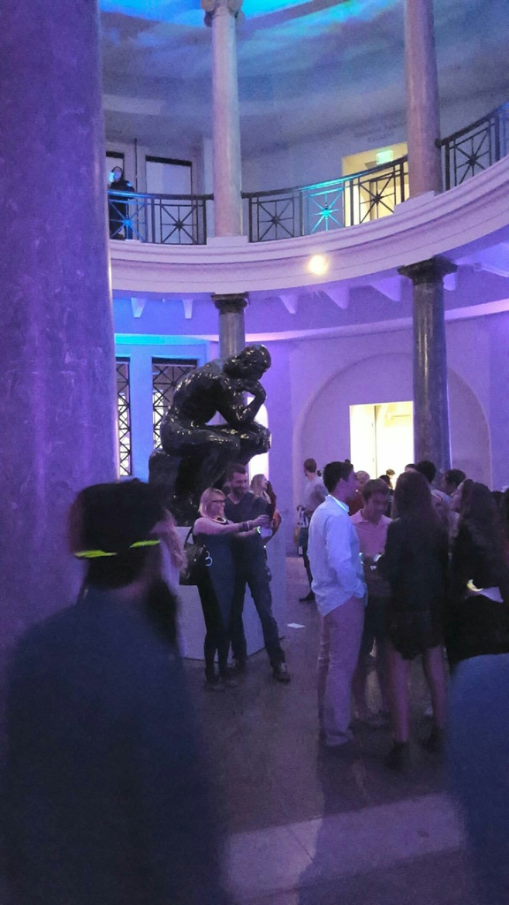
Interview Results
Party On The Edge: Cantor Art Gallery
Kim (In charge of student engagement)
Facebook events & word of mouth were main ways for her spread the word about the event to the community
Main concern was how the event was perceived by the attendees
Stated that she wanted the event to have a “loose feel” to attract students
Attributed positive experience of attendees to large crowd
“It has to feel like a party or at least seem important for anyone to enjoy these types of events & it is my job to make it happen.”
Lauren + Staff
Expressed pleasure in the large crowd
Suggested a sense of being overwhelmed when crowds reached peak numbers
Despite being overwhelmed at times they understood that big crowds were a vital part of the event

Slide 7
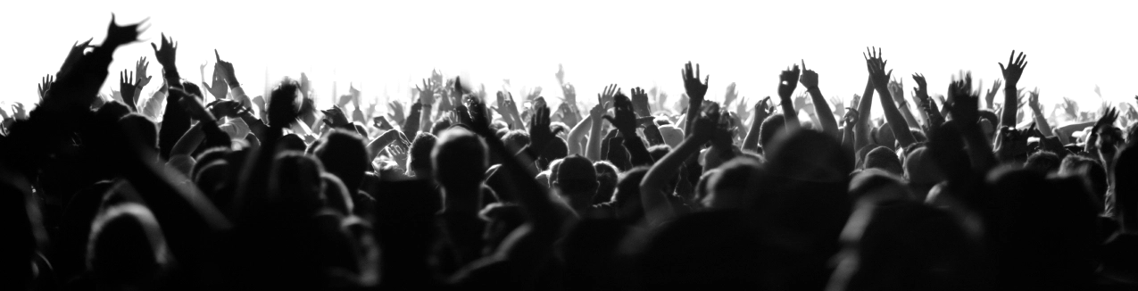
Feedback Synthesis
Crowds matter!
Crowd size & make up are an important part of attending/planning events for planners & attendees
There is a distinction between estimating how large a crowd will be and actually reacting to the crowd
Many different platforms for finding out about/advertising events & controlling who knows apart

Slide 8
Empathy Map
Say
Think
“The line and crowd as I entered was terrifying” - Janhavi
“We want BIG, but not too big.”
“It has to feel like a party for them to enjoy it.” - Kim
Organizers & guests think that crowd size will directly add or take away from the event experience depending on what the event is.
Do
Feel
Janhavi checks different sources weekly to find popular events.
Kim created “free-flowing” event with the intent to attract a large crowd.
Intimidated or Encouraged by crowd size
(depending on context)
Knowledgeable about their potential experiences (They know how they will be affected by crowd size)

Slide 9
Analysis
The size of a crowd directly affects how people interact with an event.
Key Insight:
In people’s minds there is a “sweet spot” crowd size that enhances the experience of an event.
Two Primary Needs:
To feel knowledgeable about the crowds of events
To be able to act on the knowledge of crowd size in real time

Slide 10

Summary
We interviewed event organizers and attendees about their experiences at events in relation to the size of the crowd.
The feedback we received suggests that the size of a crowd affects people’s decision making process regarding an event.
Attendees desire an ideal crowd size.

